Slide 1
Bayesian optimization
PyData London 2017
Thomas Huijskens
6th of May, 2017

Slide 2
The modelling workflow of a data scientist roughly follows three steps
Feature engineering
Feature selection
Model selection

Slide 3
In this talk, we will focus on the last step of this workflow
Feature engineering
Feature selection
Model selection
Focus of this talk

Slide 4
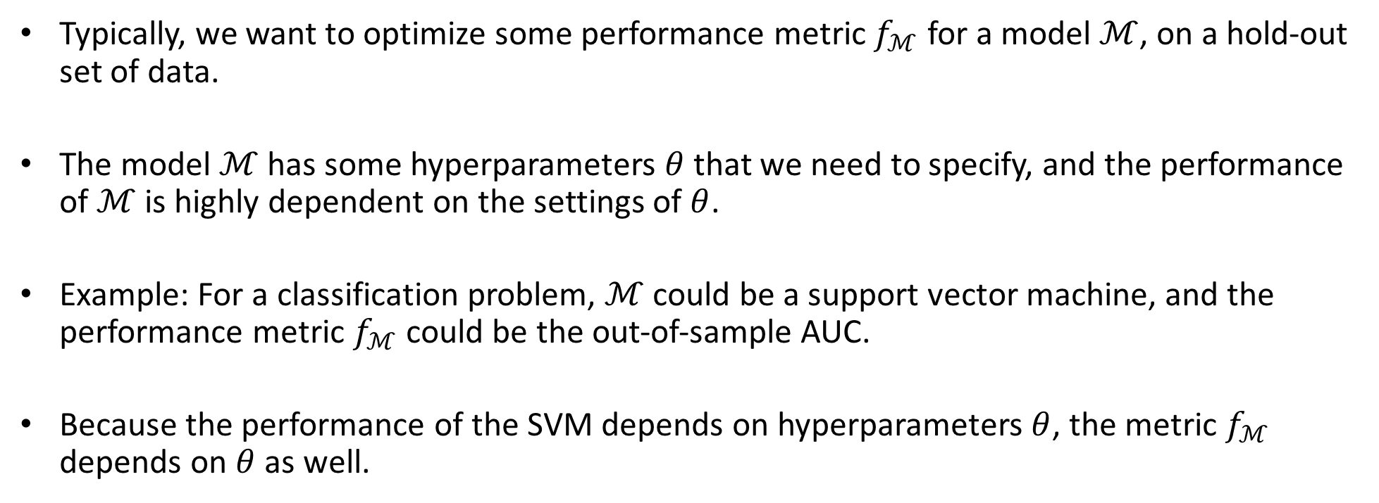
Most models have a number of hyperparameters that need to be chosen a priori..
Typically, we want to optimize some performance metric $f_{ℳ}$ for a model $ℳ$, on a hold-out set of data.
The model $ℳ$ has some hyperparameters $θ$ that we need to specify, and the performance of $ℳ$ is highly dependent on the settings of $θ$.
Example: For a classification problem, $ℳ$ could be a support vector machine, and the performance metric $f_{ℳ}$ could be the out-of-sample AUC.
Because the performance of the SVM depends on hyperparameters $θ$, the metric $f_{ℳ}$ depends on $θ$ as well.

Slide 5

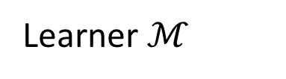
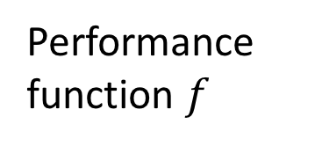
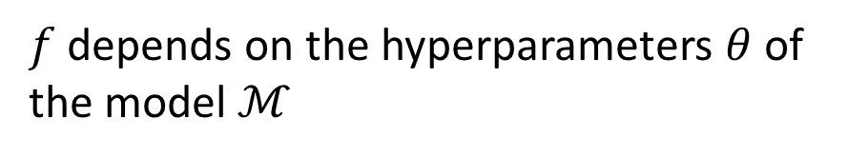
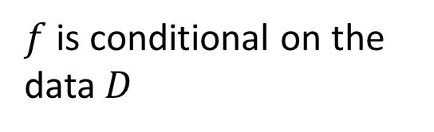
.. and our goal is to find the values of $θ$ for which the value of the (out-of-sample) performance $f_{ℳ}$ is optimal
$$f_{ℳ}\left(θ \right| D)$$
Performance function $f$
Learner $ℳ$
$f$ is conditional on the data $D$
$f$ depends on the hyperparameters $θ$ of the model $ℳ$

Slide 6
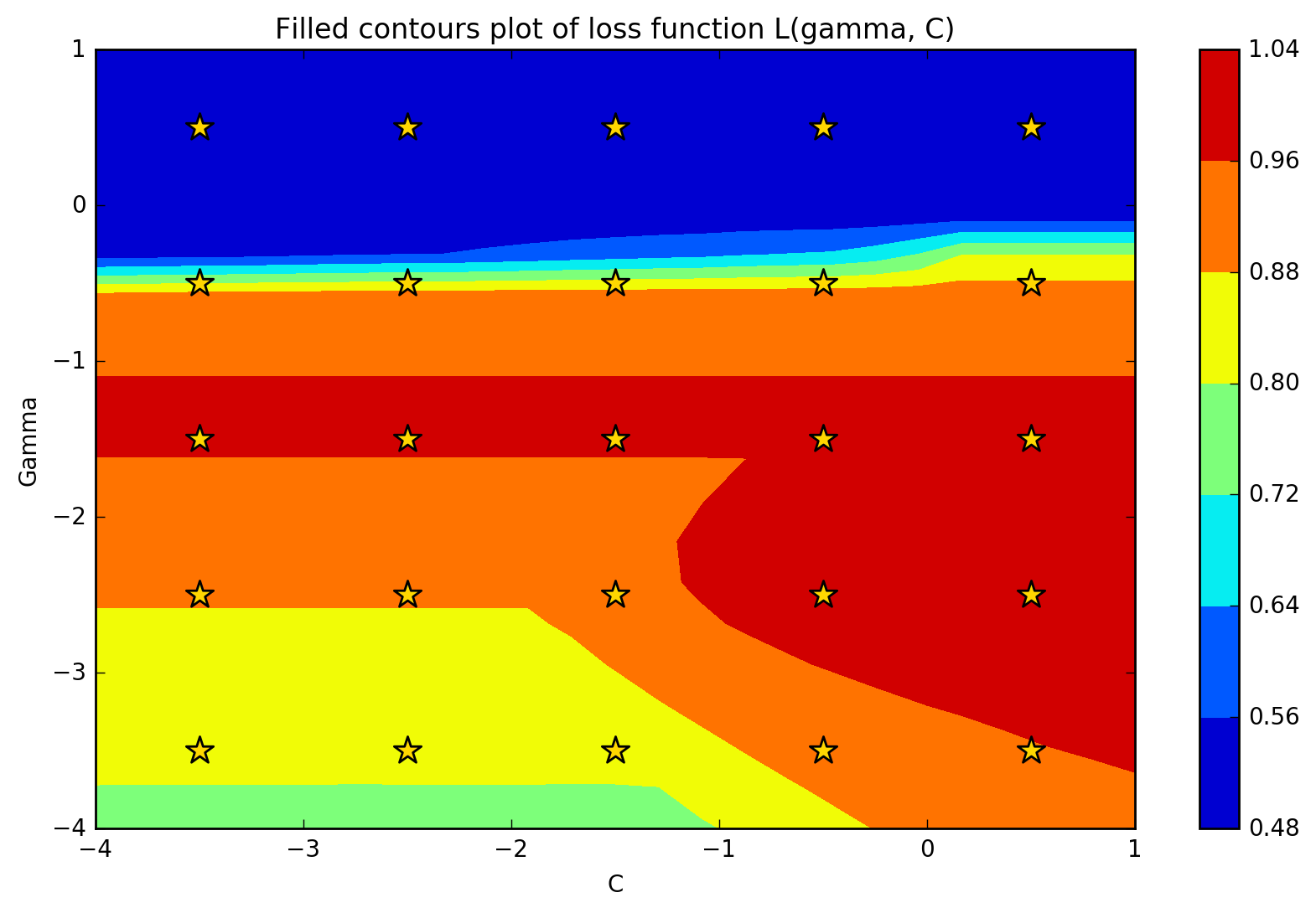
Manual grid search works for low-dimensional problems, but does not scale well to higher dimensions
Curse of dimensionality makes this inefficient in higher dimensional problems

Slide 7
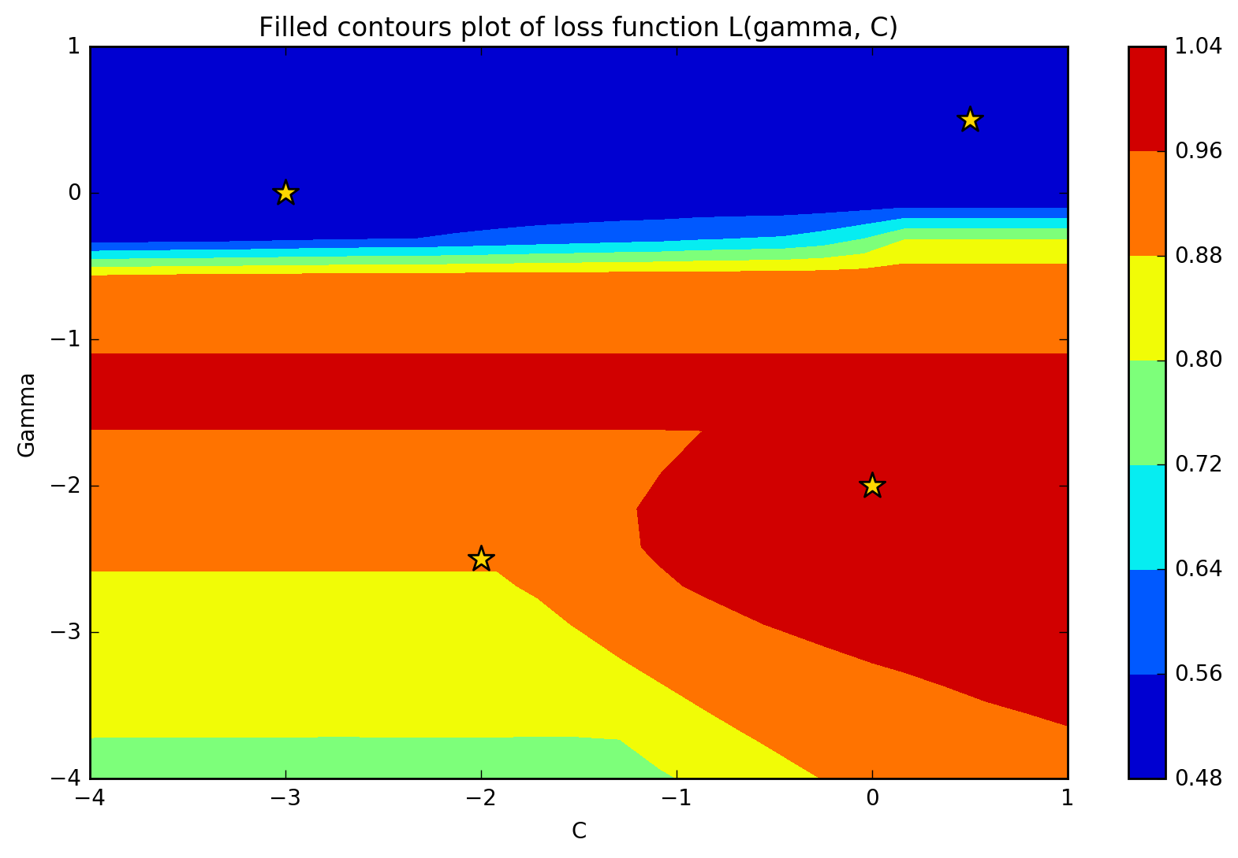
Random grid search works better in higher dimensions, but..

Slide 8
.. shouldn't previously evaluated hyperparameter values guide us in the search for the true optimal value?
Low values of L here, should probably not focus in this area
High values of L here, should probably focus in this area

Slide 9
Bayesian optimization

Slide 10
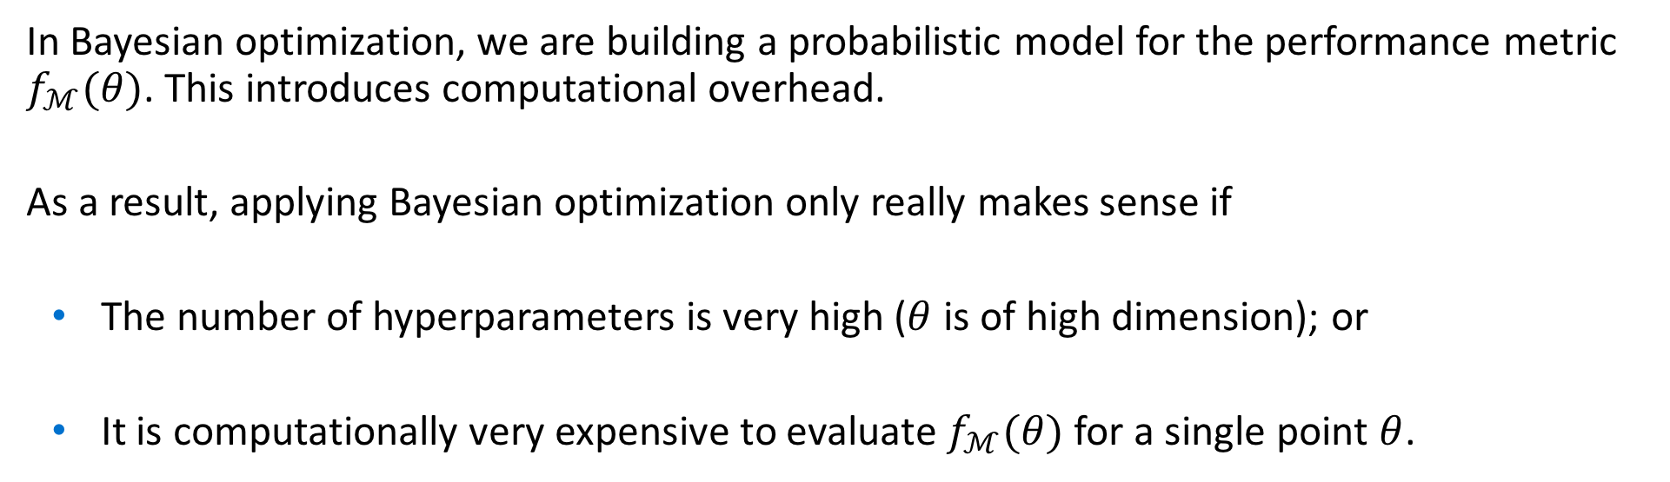
Bayesian optimization is only beneficial in certain situations
In Bayesian optimization, we are building a probabilistic model for the performance metric $f_{ℳ}(θ)$. This introduces computational overhead.
As a result, applying Bayesian optimization only really makes sense if
The number of hyperparameters is very high ($θ$ is of high dimension); or
It is computationally very expensive to evaluate $f_{ℳ}(θ)$ for a single point $θ$.

Slide 11
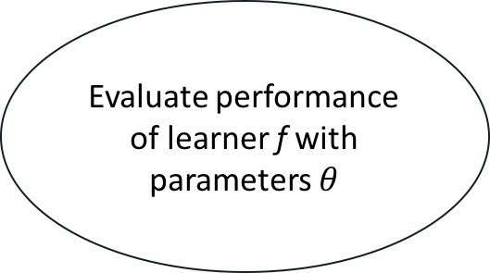
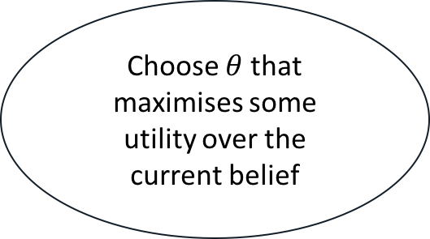

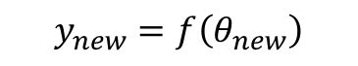
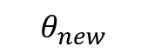
The classic Bayesian optimization algorithm consists of three steps
Evaluate performance of learner f with parameters $θ$
$$y_{new}=f\left(θ_{new}\right)$$
$$θ_{new}$$
Update current belief of loss surface of the learner f
Choose $θ$ that maximises some utility over the current belief
$$f | y_{new}$$
Notes:
Mention the similarity with general sequantial model based optimisation algorithms → this is just a special instance of an algorithm in that class.

Slide 12
The classic Bayesian optimization algorithm consists of three steps
Evaluate performance of learner f with parameters $θ$
$$y_{new}=f\left(θ_{new}\right)$$
$$θ_{new}$$
Update current belief of loss surface of the learner f
Choose $θ$ that maximises some utility over the current belief
$$f | y_{new}$$

Slide 13
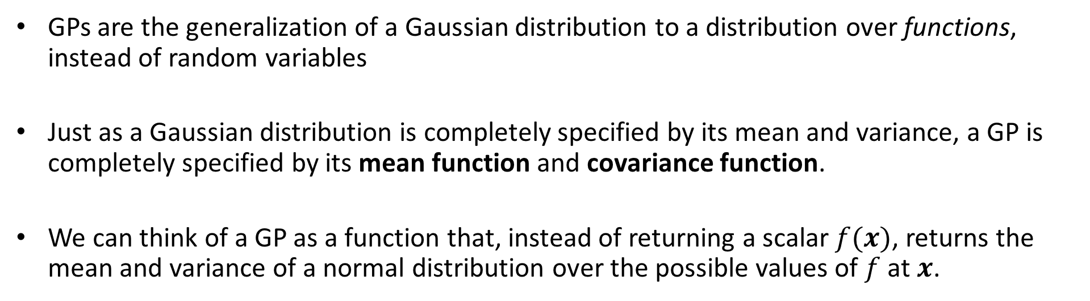
The performance function $f_{ℳ}$ is modelled using Gaussian Processes (GPs)
GPs are the generalization of a Gaussian distribution to a distribution over functions, instead of random variables
Just as a Gaussian distribution is completely specified by its mean and variance, a GP is completely specified by its mean function and covariance function.
We can think of a GP as a function that, instead of returning a scalar $f(x)$, returns the mean and variance of a normal distribution over the possible values of $f$ at $x$.

Slide 14
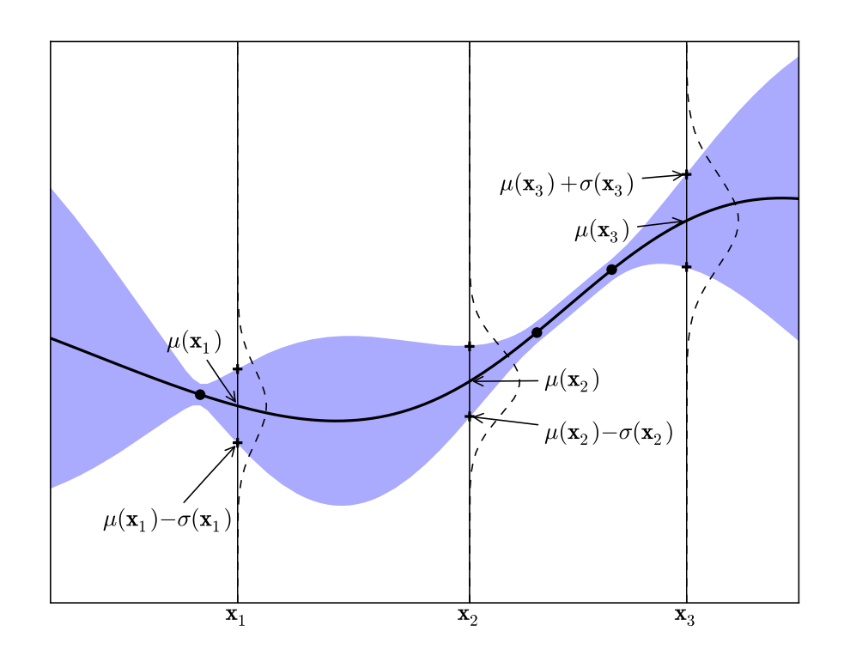
GPs are the generalization of a Gaussian distribution to a distribution over functions, instead of random variables¹
¹A Tutorial on Bayesian Optimization of Expensive Cost Functions, with Application to Active User Modeling and Hierarchical Reinforcement Learning, Eric Brochu, Vlad M. Cora, Nando de Freitas, 2010. https://arxiv.org/abs/1012.2599

Slide 15
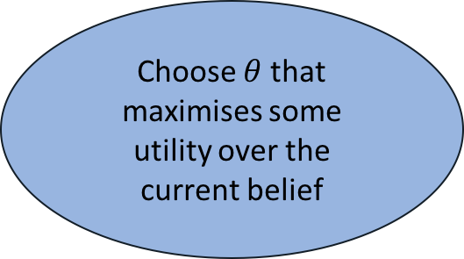
The classic Bayesian optimization algorithm consists of three steps
Evaluate performance of learner f with parameters $θ$
$$y_{new}=f\left(θ_{new}\right)$$
$$θ_{new}$$
Update current belief of loss surface of the learner f
Choose $θ$ that maximises some utility over the current belief
$$f | y_{new}$$

Slide 16
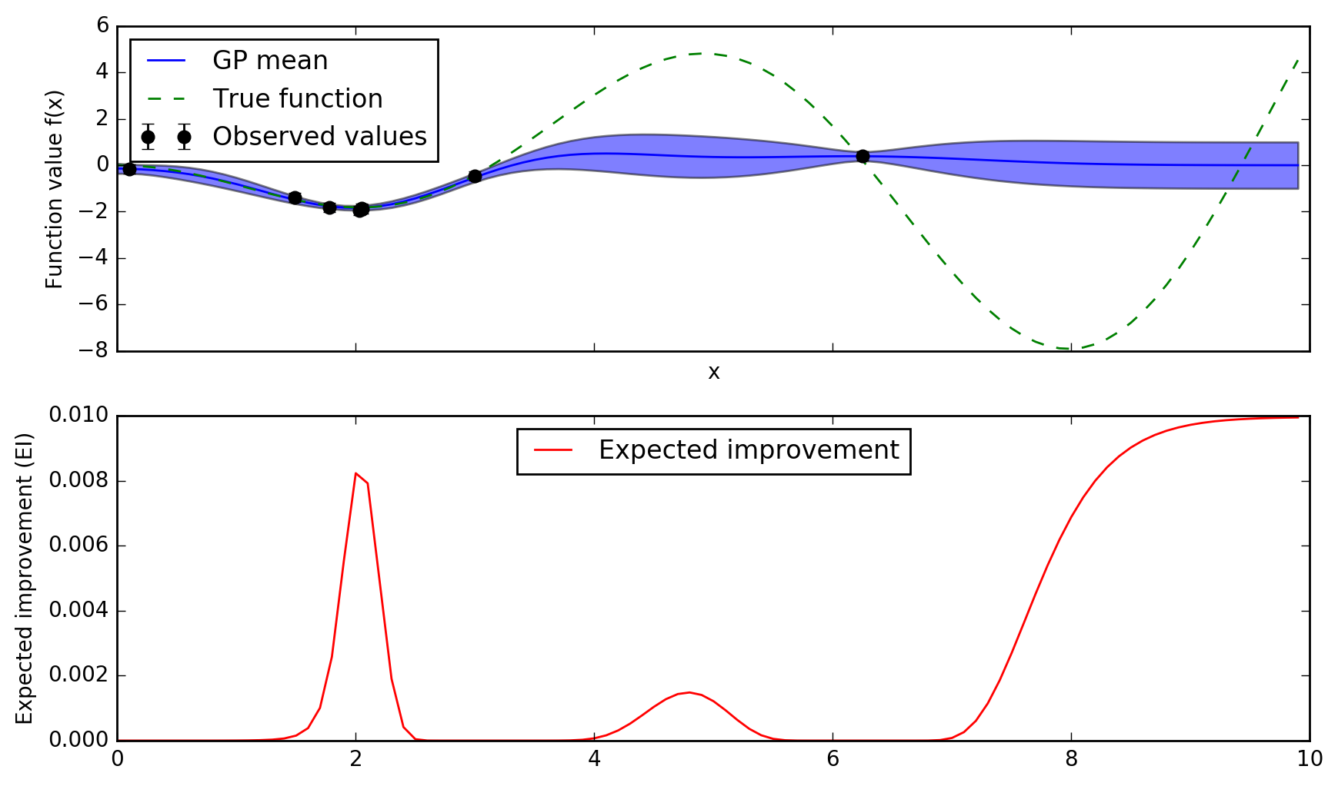
How do we use our current belief to make a good guess about what point to evaluate next?

Slide 17
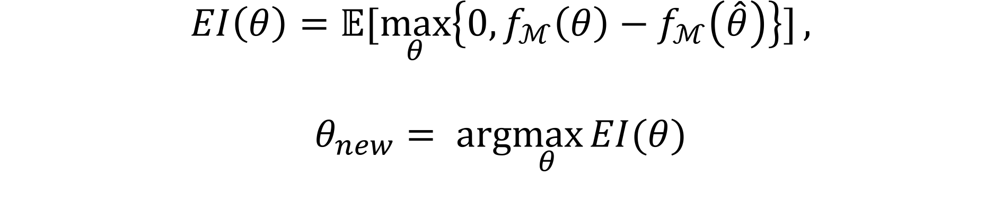
Acquisition functions are used to formalize what constitutes a ”best guess”
$$EI\left(θ\right)=𝔼[\max_{θ}\left\{0,f_{ℳ}\left(θ\right)−f_{ℳ}\left(\hat{θ}\right)\right\}],$$
$$θ_{new}= arg\max_{θ}{EI(θ)}$$

Slide 18
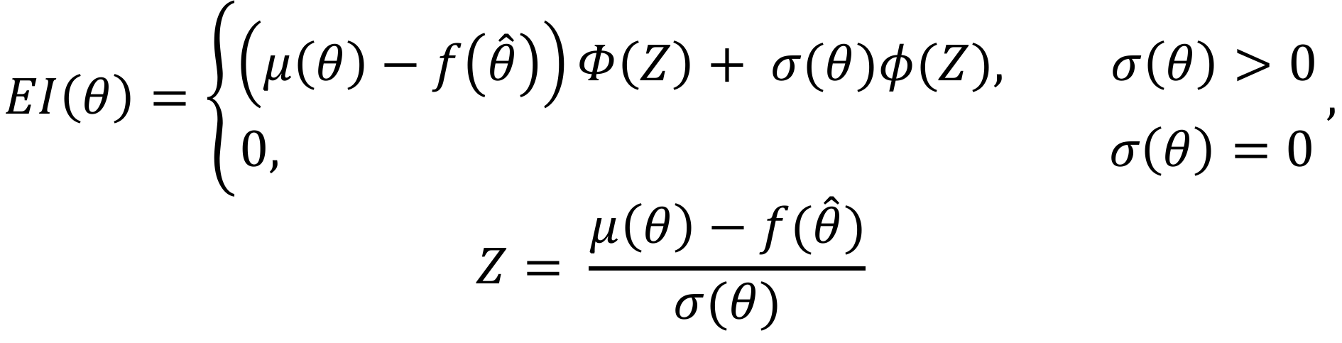
The expected improvement acquisition function can be evaluated analytically
$$EI\left(θ\right)=\left\{\begin{aligned}\left(μ\left(θ\right)−f\left(\hat{θ}\right)\right)Φ\left(Z\right)+ σ(θ)φ(Z), σ\left(θ\right)>0 \\ &0, σ\left(θ\right)=0\end{aligned}\right.,$$
$$Z= \frac{μ\left(θ\right)−f(\hat{θ})}{σ(θ)}$$

Slide 19
The expected improvement acquisition trades off exploitation of known optimal areas, versus exploration of unexplored areas of the loss surface
Exploitation of known optimal space
Exploration of unknown space
Exploration of unknown space

Slide 20
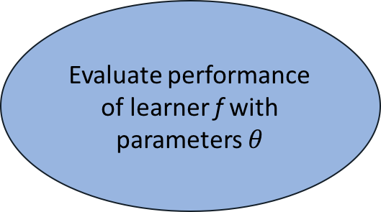
The classic Bayesian optimization algorithm consists of three steps
Evaluate performance of learner f with parameters $θ$
$$y_{new}=f\left(θ_{new}\right)$$
$$θ_{new}$$
Update current belief of loss surface of the learner f
Choose $θ$ that maximises some utility over the current belief
$$f | y_{new}$$

Slide 21
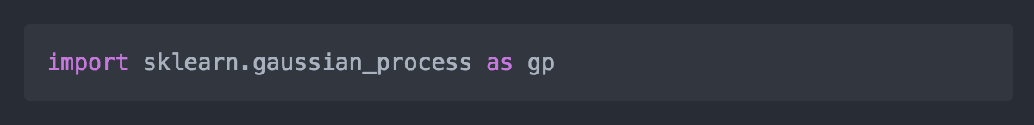
How do we use this in real-life?

Slide 22
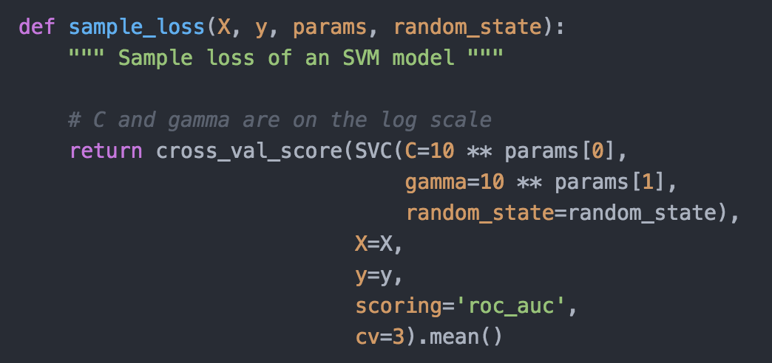
Example – Bayesian optimization can be used to tune the hyperparameters of an SVM model

Slide 23
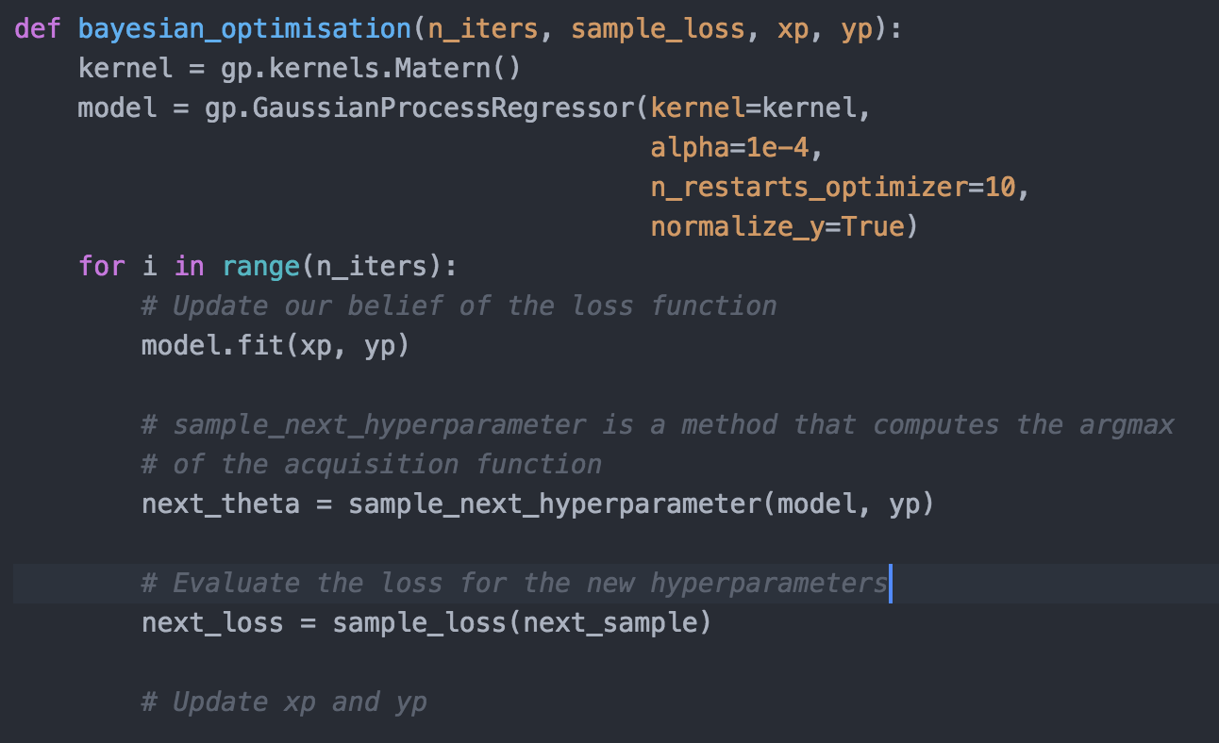
Example – A pseudocode implementation of Bayesian optimization shows its simple API

Slide 24
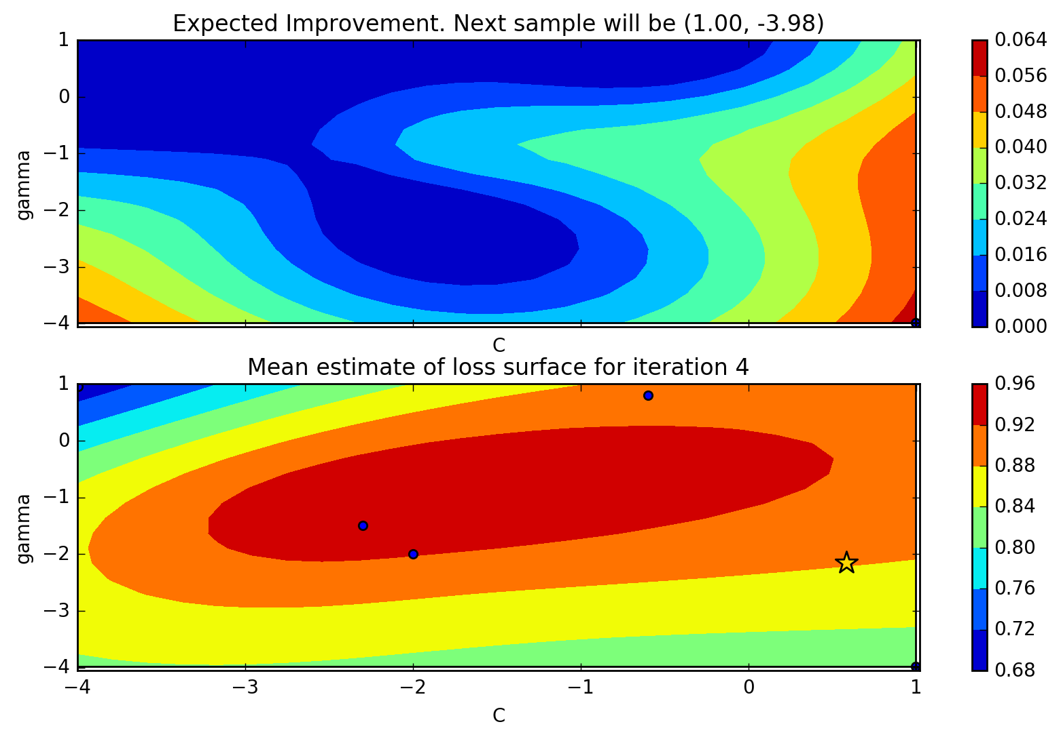
Example – Bayesian optimization can be used to tune the hyperparameters of an SVM model

Slide 25

Example – Bayesian optimization can be used to tune the hyperparameters of an SVM model

Slide 26
GPs can not be used as a simple black-box, and some care must be taken
Choose an appropriate scale for your hyperparameters: For parameters like a learning rate, or regularization term, it makes more sense to sample on the log-uniform domain, instead of the uniform domain.
Choose the kernel of the GP carefully: Each kernel implicitly assumes different properties on the loss function, in terms of differentiability and periodicity.

Slide 27
Multiple production-ready, and open-source, modules for Bayesian optimization are available online
Spearmint
Hyperopt
MOE
Hyperband (model-free)
SMAC (model-free)

